Slide 1
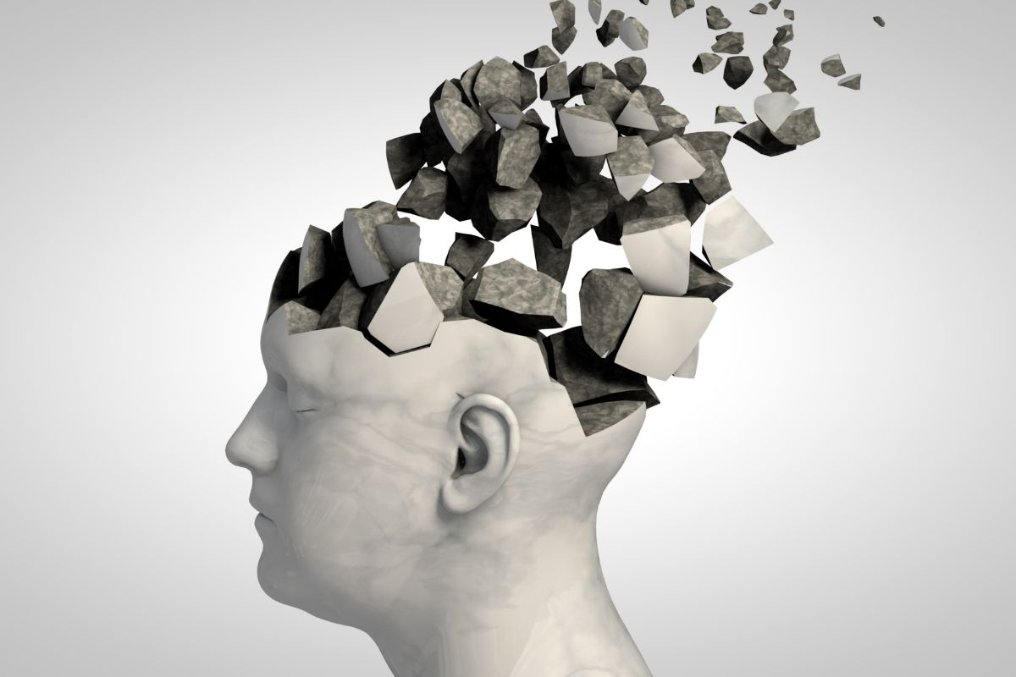
Creating Innovative Healthcare Apps for Dementia Patients and Caregivers.
TMP-23-365

Slide 2
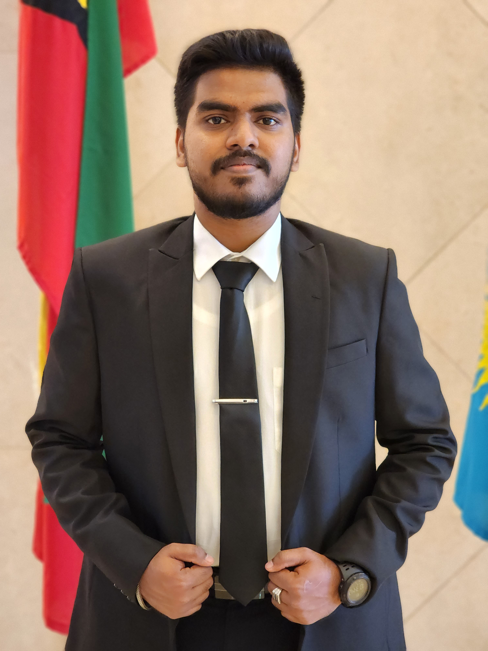
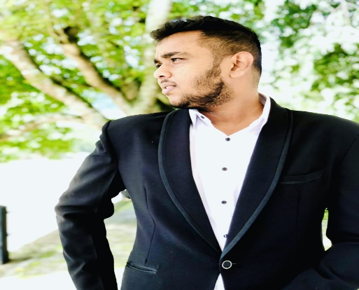
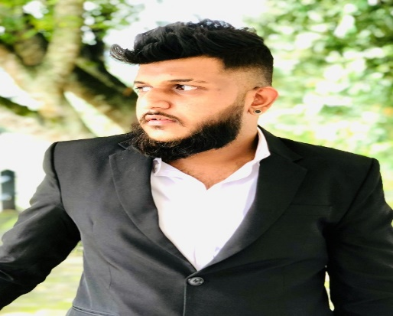
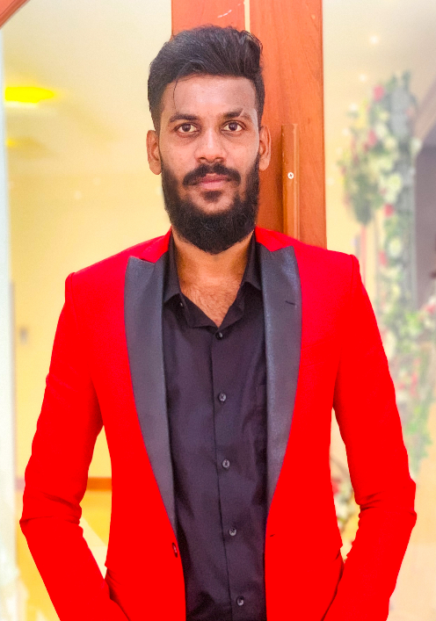
Hello! Our members are
Student Name | Student ID
Samarathunga S.R.L | IT20151942
Weerasinghe H.P.E.N | IT20142414
Warnakulasuriyage K.H.A | IT20151492
Serasingha K.A.E.Y.D | IT20121242

Slide 3
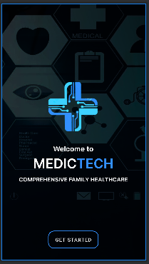
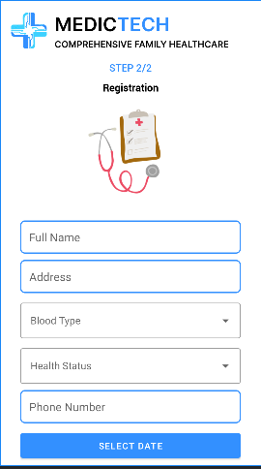
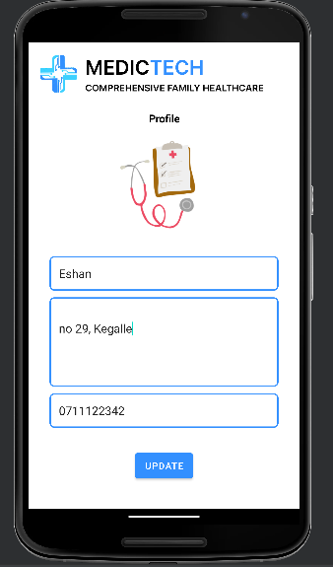
Mobile App View

Slide 4
Introduction
The research aims to address the challenge of providing appropriate care and support to individuals over the age of 65 with dementia, who may find it challenging to manage their health conditions due to busy lifestyles and insufficient assistance from family members.
The system also includes a mobile app and wearable devices for patients to monitor their health status and communicate with their healthcare team.
The focus is on prioritizing patient privacy and security and considering the cognitive limitations of dementia patients.
Our research intends to showcase how these technologies can improve dementia patients' outcomes, increase healthcare efficiency, and provide personalized care.

Slide 5
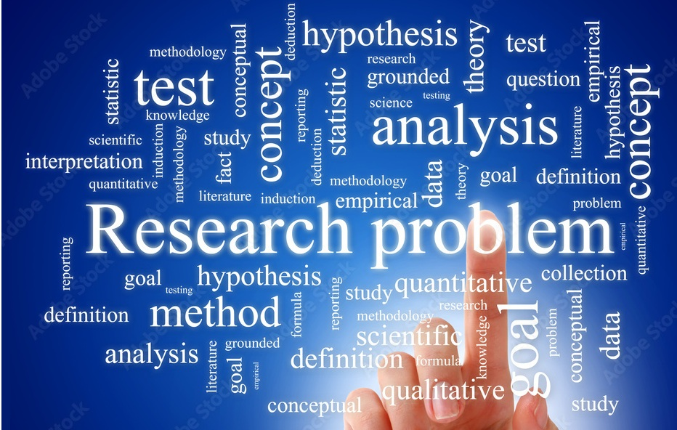
Research Problem
The problem addressed by this research is the difficulty in providing appropriate care and support to elderly individuals with dementia, who may struggle to manage their health conditions due to cognitive limitations and lack of assistance.
This can lead to health concerns that require medical attention but are not addressed until they become critical, as the patients may not seek help or be aware of hazardous health situations.
There is a need for a solution that can deliver reliable health monitoring and intervention to dementia patients, enhance their quality of life, and prevent medical emergencies.

Slide 6
Objectives
Main objective
To develop a user-friendly healthcare system for dementia patients that tracks their daily activities, meals, critical situations, and mental health, and generates reports for doctors to understand their health status.
Sub-objective
To develop a system that suggests video clips based on ML and Image processing to improve the mood of dementia patients according to their current emotional state, using image processing to detect their facial expressions.
To use machine learning to provide personalized meal and exercise plans based on data collected from IoT devices.
To develop a warning system using machine learning that alerts both the patient and the team of caregivers, using data from IoT devices.And using another matching learning part and check patient have or not dementia.
To automatically generate a monthly patient health status report based on data collected from IoT devices, send the report to caregivers, and predict health status.

Slide 7
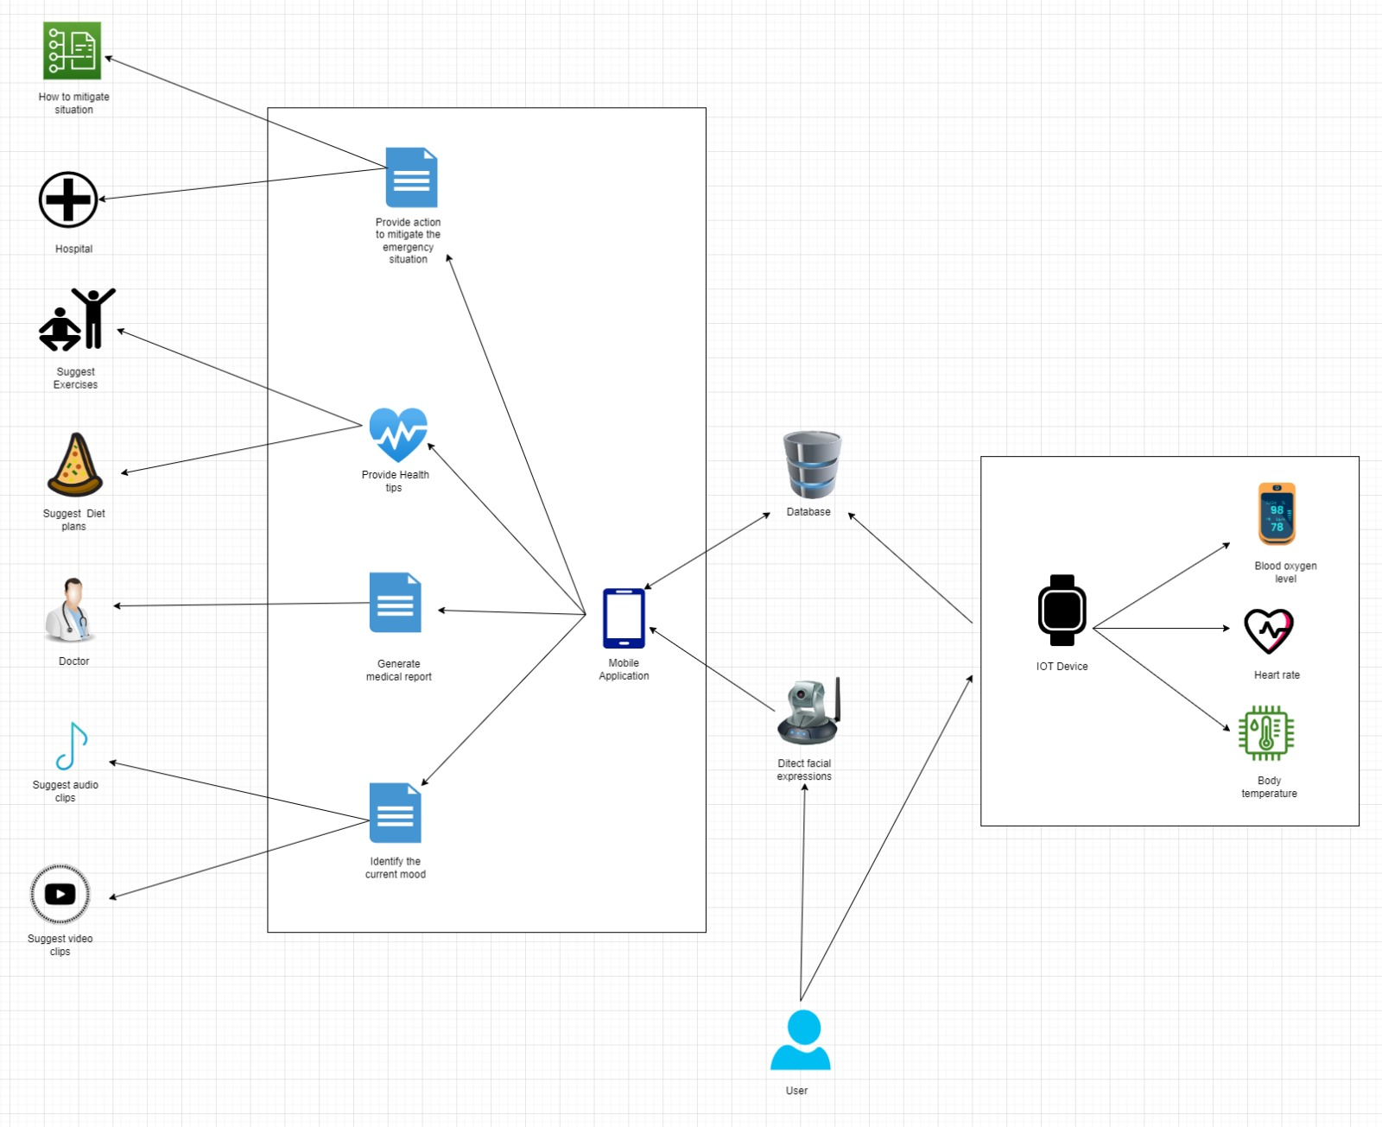
Overall System Diagram

Slide 8

Commercialization
Marketing is based on Dementia Patients platform.
Free to use.
24/7 automated.
Easy with navigation.

Slide 9
Budget
Things | Price
Virtual Machine with better GPU | Not yet subscribed
Transportation | 7,000
Datasets | If needed
Research Paper Publishing | 20,000

Slide 10

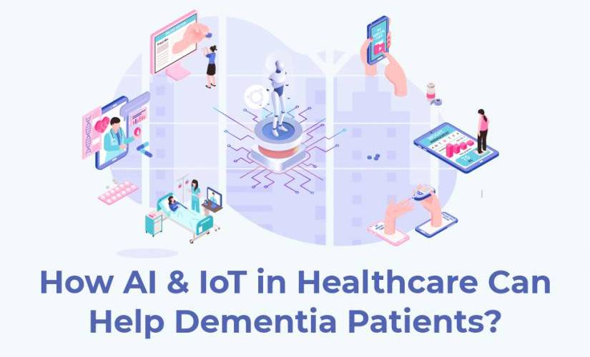
IT20151942 | Samarathunga S.R.L.
Information Technology

Slide 11
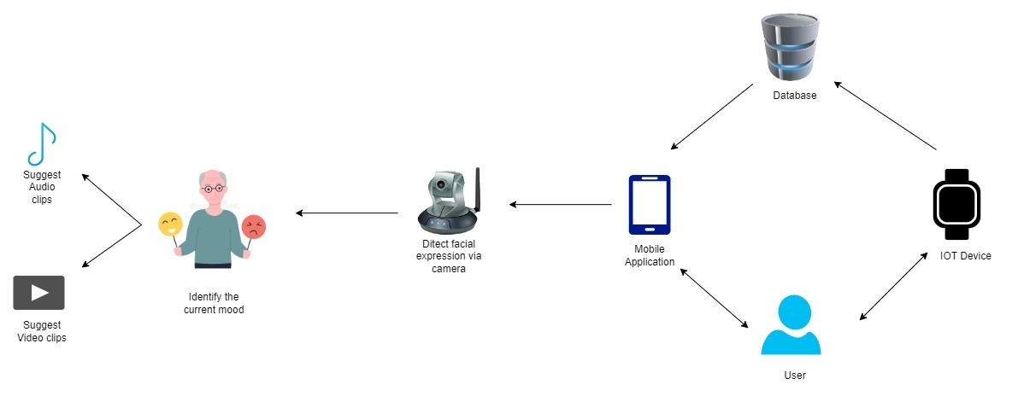
System Diagram
IT20151942 | << Samarathunga S.R.L.>> >> | <<TPM-23-365>>

Slide 12
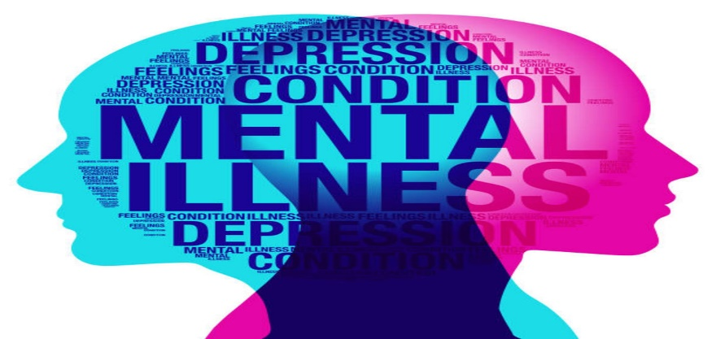
Background
Dementia is a cognitive disorder that affects millions of people worldwide, and its prevalence is expected to increase with an aging population.
Dementia patients may experience changes in mood and behavior, which can be challenging for both the patient and their caregivers. Technology, particularly artificial intelligence (AI), can provide new possibilities for healthcare professionals to diagnose and treat dementia patients.
Image processing provides a more accurate and efficient method for detecting and addressing the emotional and behavioral changes in dementia patients.
IT20151942 | << Samarathunga S.R.L.>> >> | <<TPM-23-365>>

Slide 13
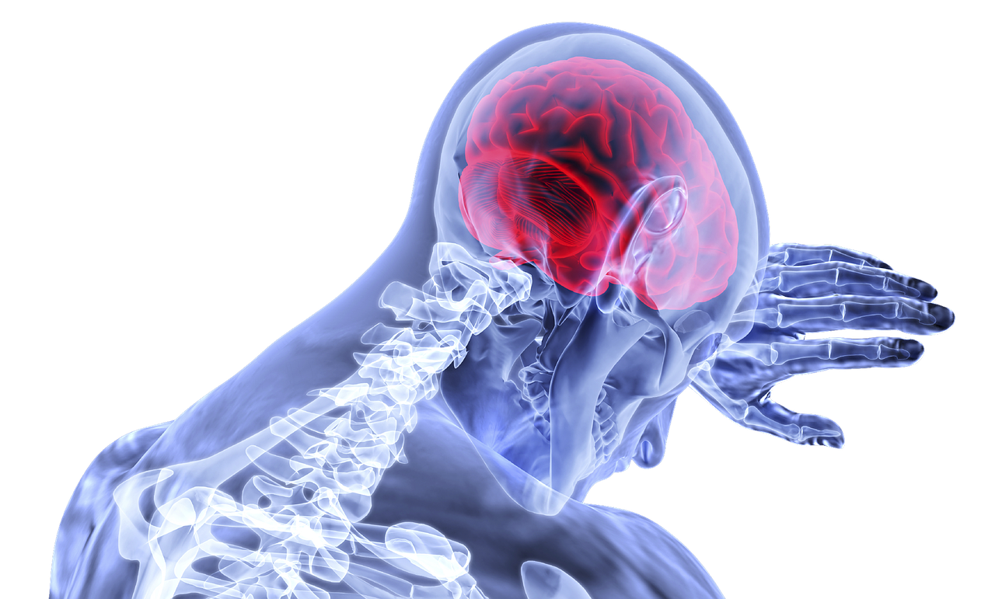
RESEARCH PROBLEM
Dementia patients often experience changes in mood and behavior, which can be challenging to diagnose and treat due to the subjective nature of emotions.
Traditional methods of treating mood disorders can be expensive, time-consuming, and may not be accessible to everyone.
Therefore, there is a need for an efficient and accessible method for treating the mood changes in dementia patients.
IT20151942 | << Samarathunga S.R.L.>> >> | <<TPM-23-365>>

Slide 14
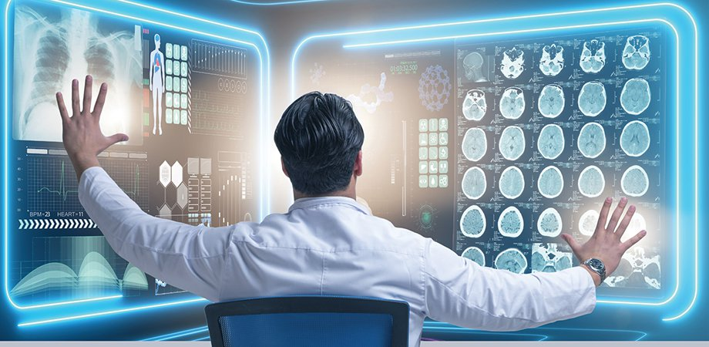
OBJECTIVES
Main Objectives
The main objective of this research is to develop a system that suggests video clips based on ML and image processing to fix the mood that suits the dementia Patients’ current situation. The system will use image processing to detect the dementia patient's facial expressions and identify their current emotional state.
Sub Objectives
To identify the Dementia patient's current situation using image processing.
To suggest appropriate video clips that can improve the patient's mood.
IT20151942 | << Samarathunga S.R.L.>> >> | <<TPM-23-365>>

Slide 15
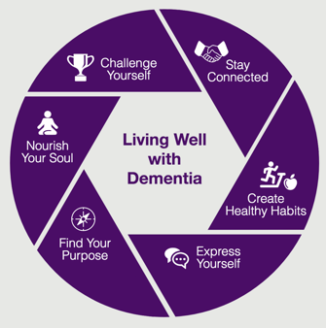
Methodology
The system will use a combination of AI algorithms, image processing techniques, and natural language processing (NLP) to achieve the main objectives.
First, the system will detect the facial expressions of the patient using image processing.
Based on the patient's emotional state, the system will suggest audio and video clips that can improve their mood.
The system will continuously learn and improve its accuracy with each interaction.
IT20151942 | << Samarathunga S.R.L.>> >> | <<TPM-23-365>>

Slide 16
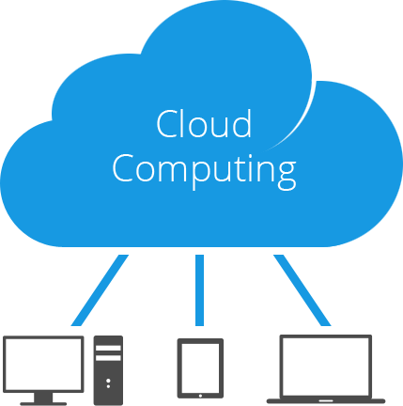

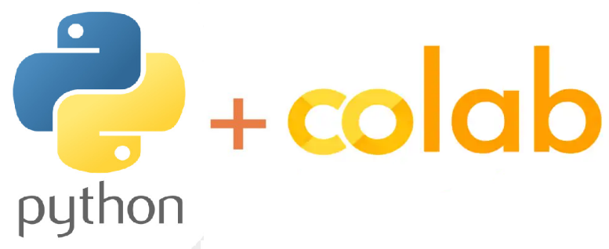
TECHNOLOGIES TO BE USED
Google collab (for Train ML)
Machine learning (neural networks could be used(CNN))
Cloud computing (To handle the large amounts of data involved in image processing and machine learning.)
Mobile app development (java for frontend and a back-end programming language Python)
IT20151942 | << Samarathunga S.R.L.>> >> | <<TPM-23-365>>

Slide 17
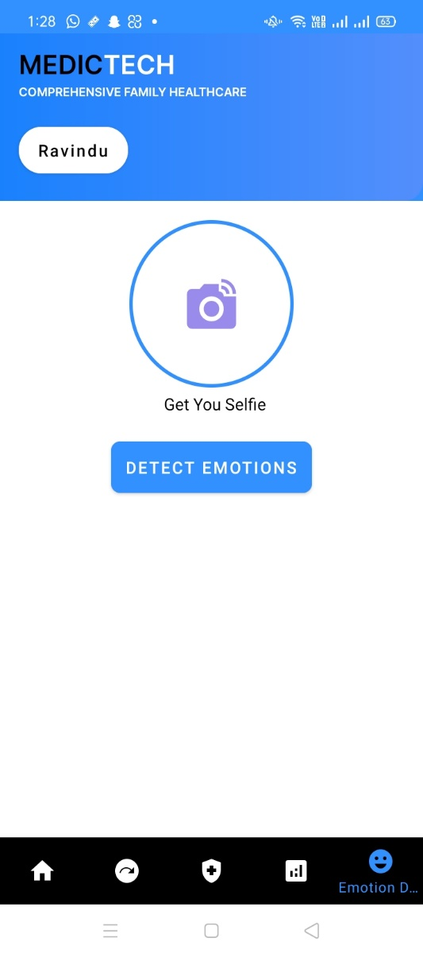
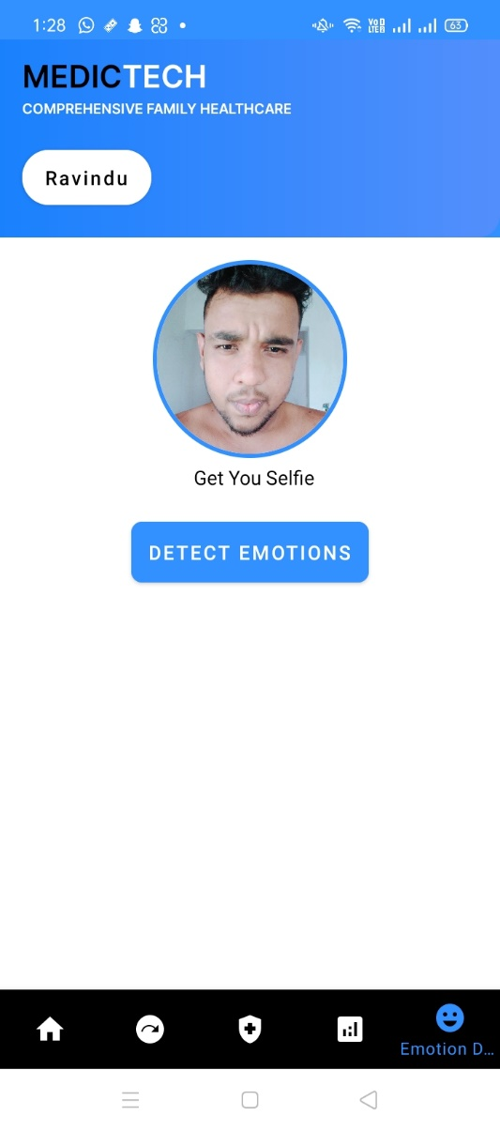
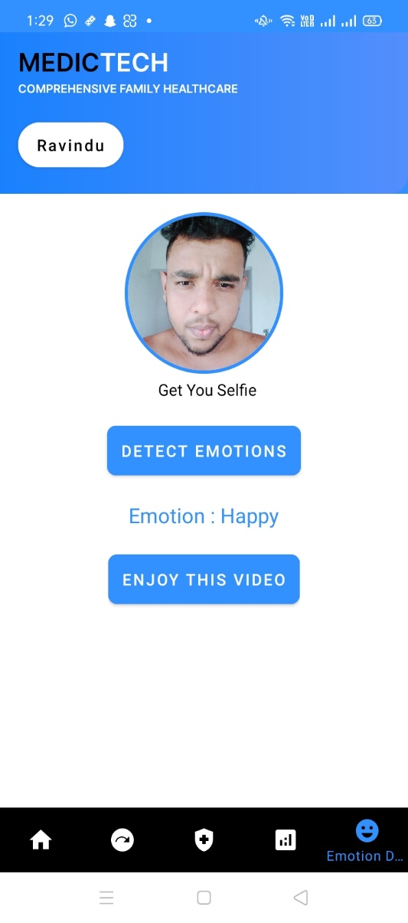
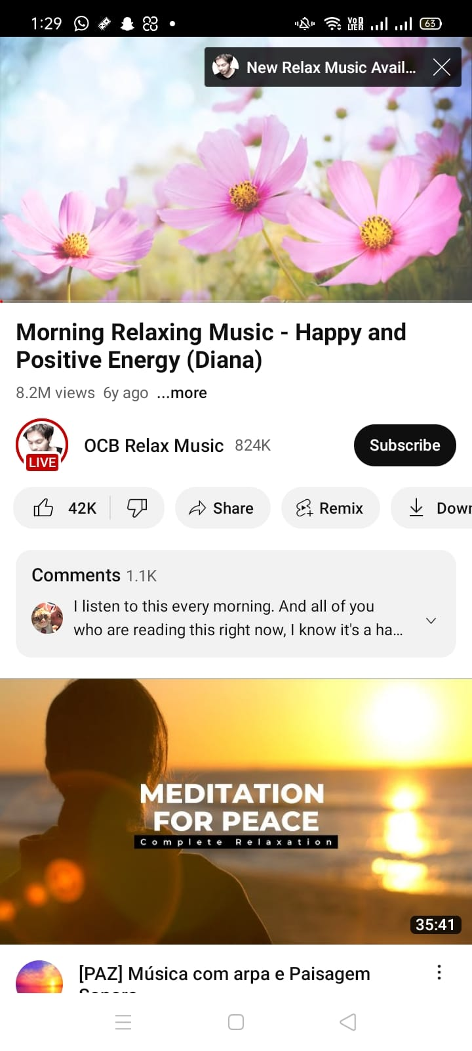
Interfaces

Slide 18
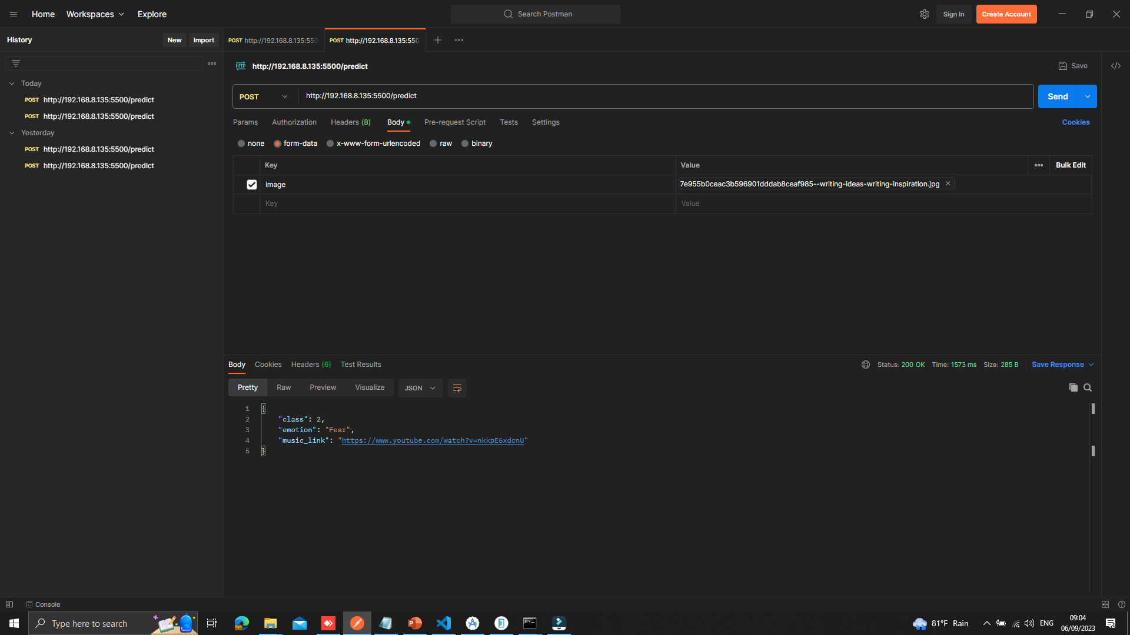
Backend Process..

Slide 19
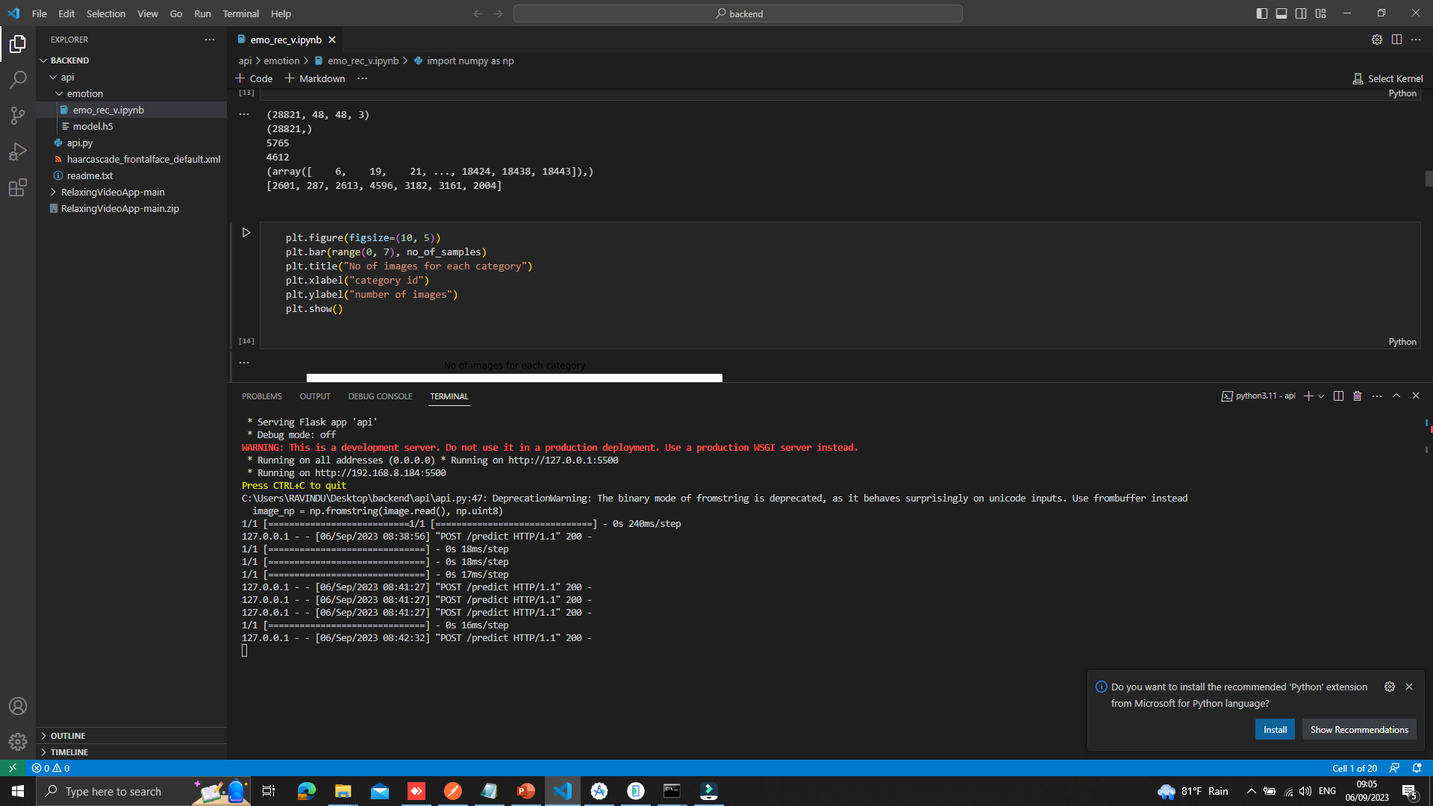
ML Process So Far…

Slide 20
RESEARCH GAP
Mobile App | Related to Identifying Emotional State | Related to Suggesting Audio Clips | Related to Suggesting Video Clips
Proposal App | YES | YES | YES
EmoReact | YES | NO | NO
EmoVu | YES | NO | NO
Feel | NO | YES | YES
Moodfit | NO | YES | YES
Affectiva | YES | NO | NO
IT20151942 | << Samarathunga S.R.L.>> >> | <<TPM-23-365>>

Slide 21
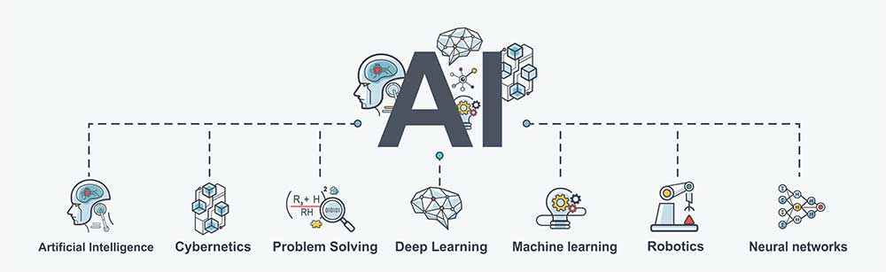
Requirements
System
16GB Ram , Core i7 10 Generation , good GPU , 512GB SSD
Personal
Image processing skills , Machine learning , AI
IT20151942 | << Samarathunga S.R.L.>> >> | <<TPM-23-365>>

Slide 22
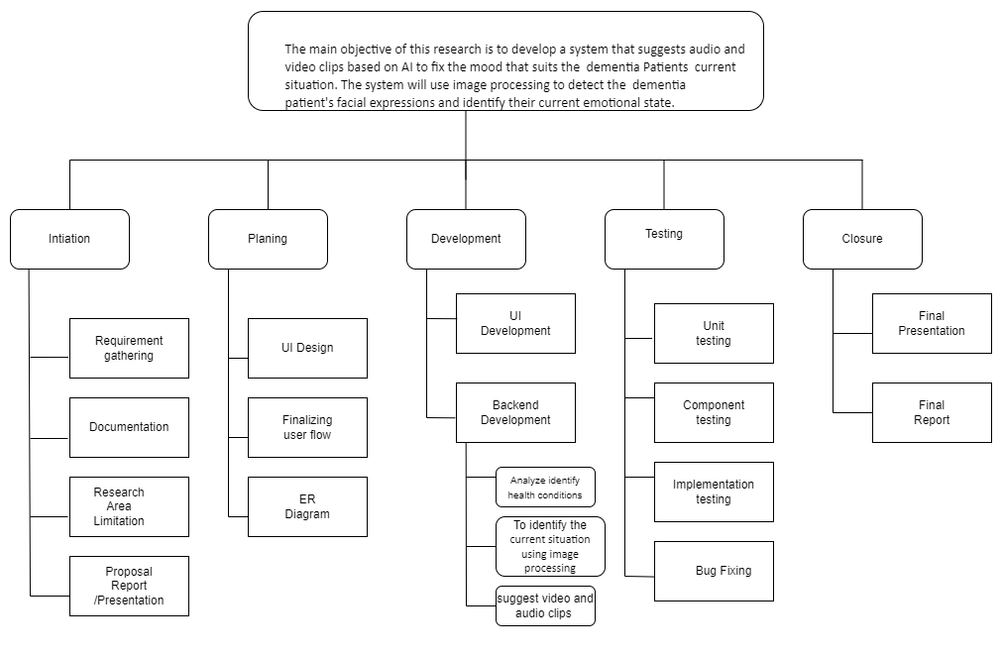
WBS Diagram
IT20151942 | << Samarathunga S.R.L.>> >> | <<TPM-23-365>>

Slide 23
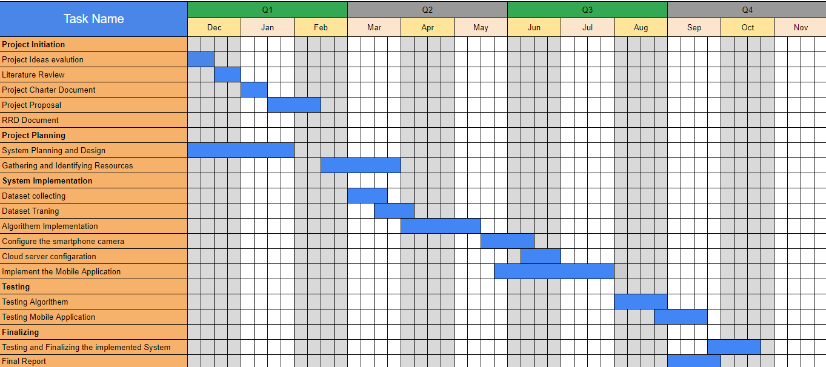
Gantt Chart
IT20151942 | << Samarathunga S.R.L.>> >> | <<TPM-23-365>>

Slide 24
Reference
"Affective Computing and Intelligent Interaction: A Survey" by Rosalind W. Picard: https://ieeexplore.ieee.org/document/890324
"Facial expression recognition for patients with dementia based on deep learning" by Juanjuan Zhao, et al.: https://www.sciencedirect.com/science/article/abs/pii/S1877050919316007
"Music Therapy in Dementia: A Narrative Synthesis Systematic Review" by Emma Brooker, et al.: https://journals.sagepub.com/doi/abs/10.1177/0269215520916780
"Effectiveness of video-based interventions for individuals with dementia: A systematic review and meta-analysis" by Jia Xu, et al.: https://www.sciencedirect.com/science/article/pii/S0197457219308349

Slide 25


IT20142414 | Weerasinghe h.p.e.n
Information Technology
Give health tips for the user based on the data collected from IoT device using Machine learning
IT20142414 | <<Weerasinghe H.P.E.N>> | <<TMP-23-365>>

Slide 26
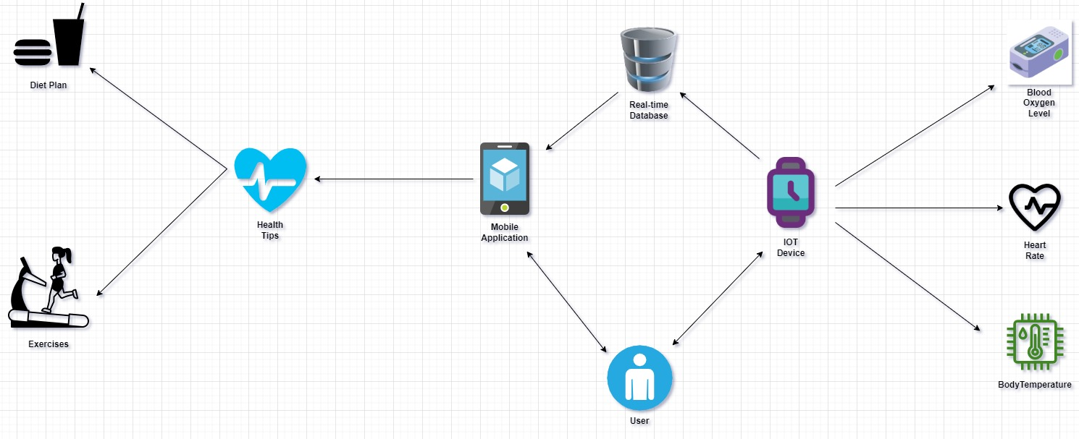
System Diagram
IT20142414 | << Weerasinghe H.P.E.N.>> >> | <<TPM-23-365>>

Slide 27
Background
Sri Lanka has a high prevalence of Alzheimer's and dementia, with 6,939 deaths in 2020, accounting for 5.98% of total deaths and ranking Sri Lanka #14 in the world for age-adjusted death rate (27.62 per 100,000 population).
A smart wearable device has been developed to measure key health factors, including heart rate, blood oxygen level, and body temperature.
These factors are stored in a real-time database.
Upon registration, the user's initial health data is collected and stored in the system.
A machine learning algorithm is used to analyze the stored data in conjunction with the user's health data.
The analysis is used to generate personalized health tips for the user.
Health tips are provided in the form of exercises and diet plans tailored to the user's current health status.
The system aims to promote healthy habits and provide personalized health advice to enhance the well-being of elderly individuals suffering from dementia..
IT20142414 | << << Weerasinghe H.P.E.N >> >> | <<TPM-23-365>>

Slide 28
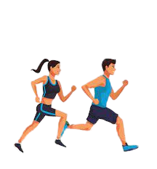
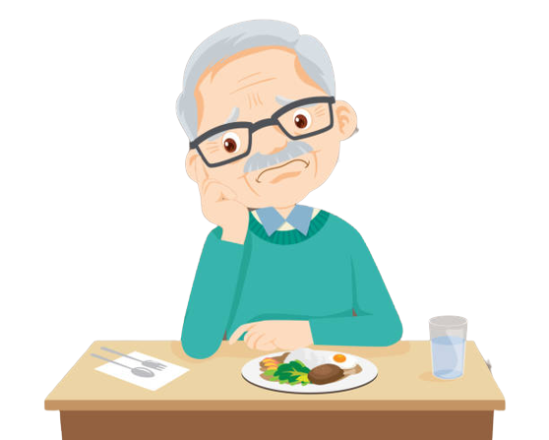
RESEARCH PROBLEM
Individuals consuming foods and beverages that are not appropriate for their health status is a common issue. This behavior can harm their physical health, potentially leading to the development of chronic diseases and other health complications.
The reluctance of individuals to engage in physical exercise as a means of maintaining their health
IT20142414 | << Weerasinghe H.P.E.N>> >> | <<TPM-23-365>>

Slide 29
OBJECTIVES
Main Objectives
Provide personalized health tips, diet plans, and exercises to users based on their current health status as measured by their blood oxygen level, body temperature, and heart rate. This objective aims to improve the overall health and quality of life of users by promoting healthy habits tailored to their individual needs.
Sub Objectives
Provide Diet plans.
Provide exercises.
IT20142414 | << Weerasinghe H.P.E.N.>> >> | <<TPM-23-365>>

Slide 30
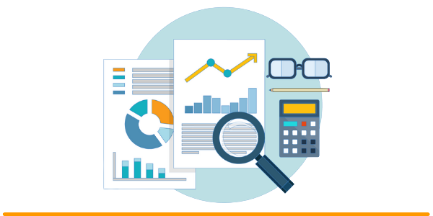
Methodology
To Implement Functionality to Meal and Exercise :
Machine Learning Algorithm
Python
Tools and Technologies:
JAVA, AWS, Android Studio and Visual Studio
IT20142414 | << Weerasinghe H.P.E.N.>> >> | <<TPM-23-365>>

Slide 31
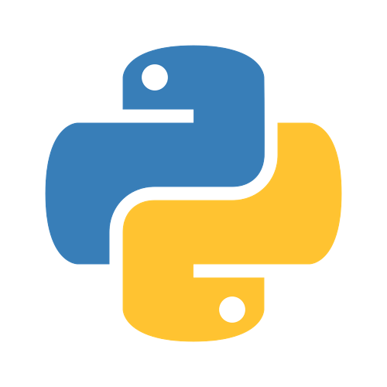


TECHNOLOGIES TO BE USED
Machine Learning
Java
Android studio
Python
IT20142414 | << Weerasinghe H.P.E.N >> | <<TPM-23-365>>

Slide 32
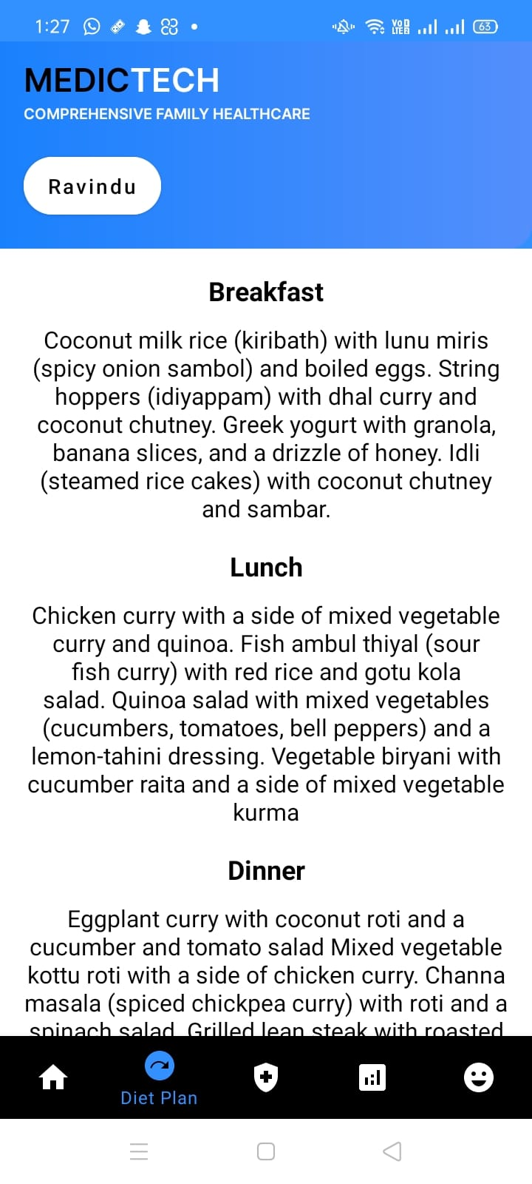
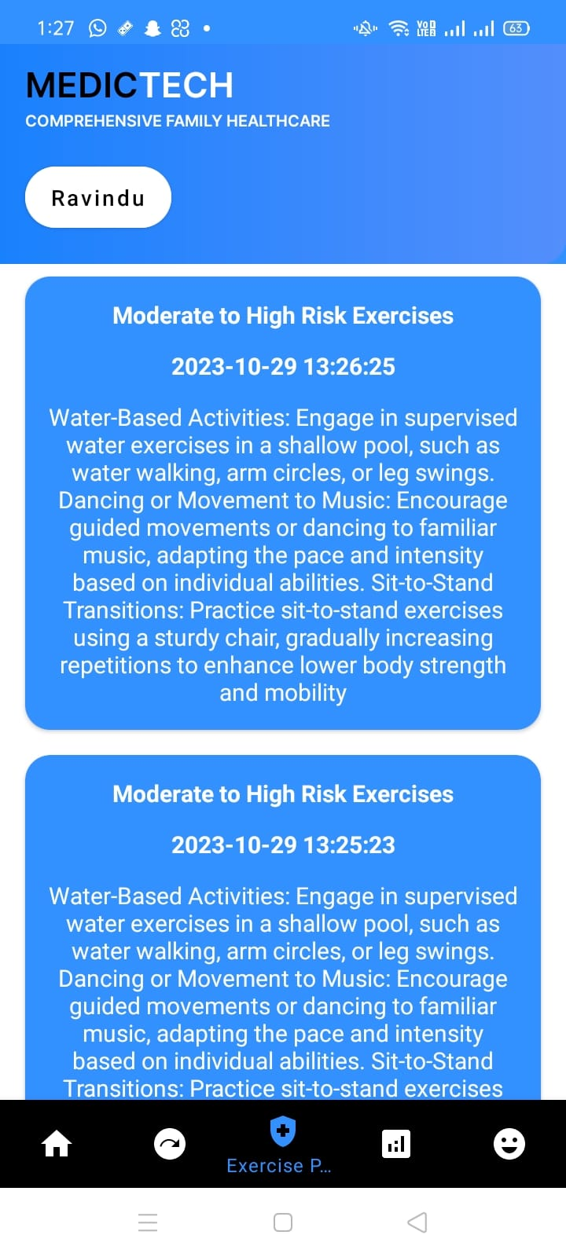
Interfaces
IT20142414 | <<Weerasinghe H.P.E.N>> | <<TMP-23-365>>

Slide 33
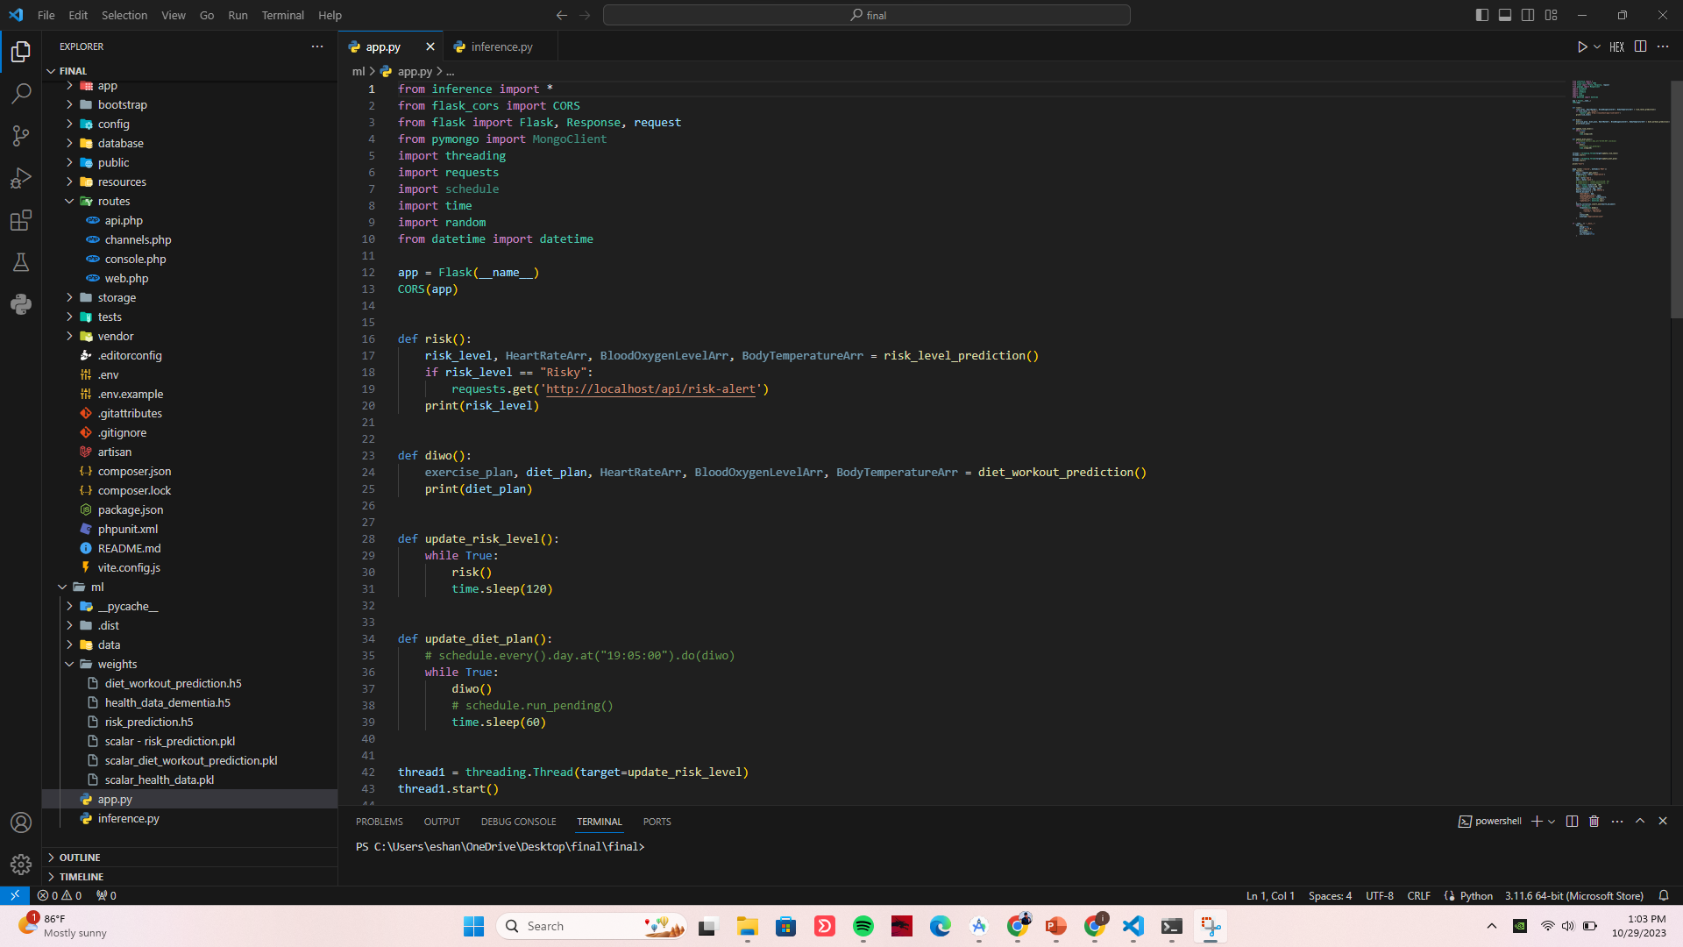
Backend Process..
IT20142414 | <<Weerasinghe H.P.E.N>> | <<TMP-23-365>>

Slide 34
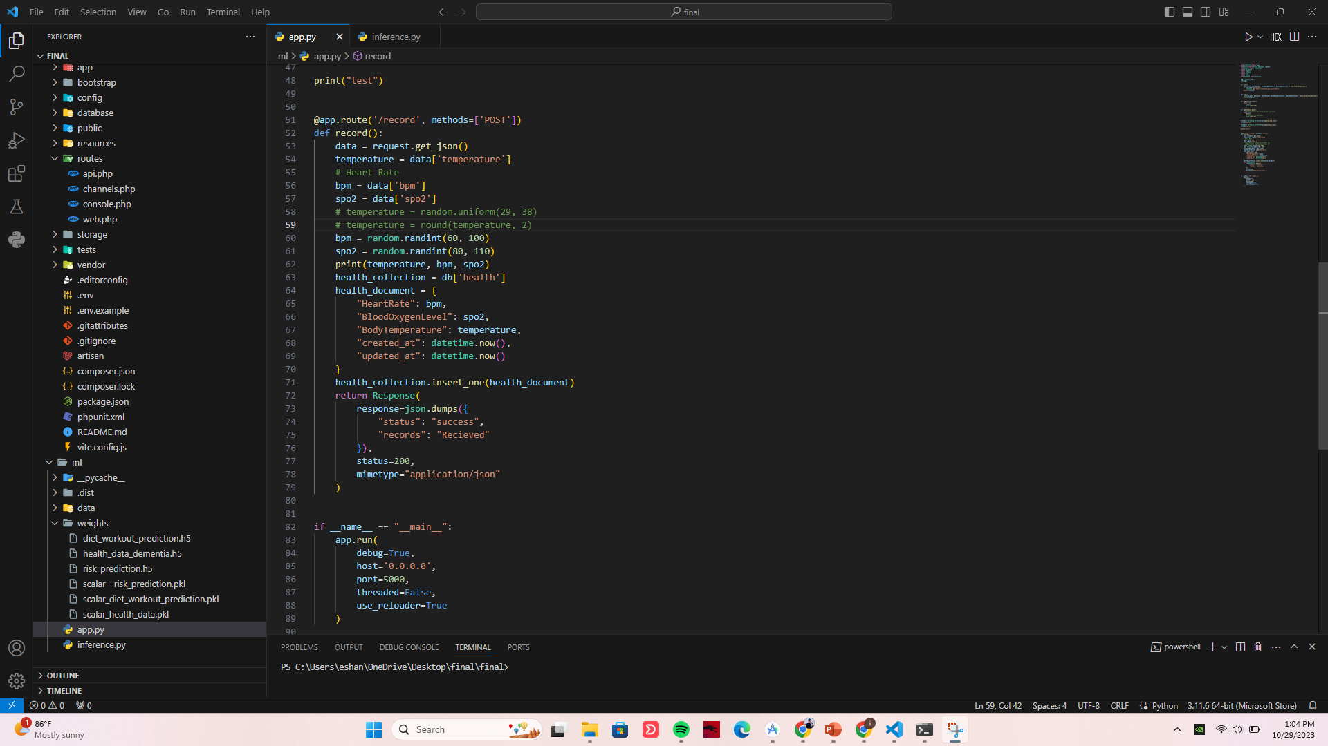

Slide 35
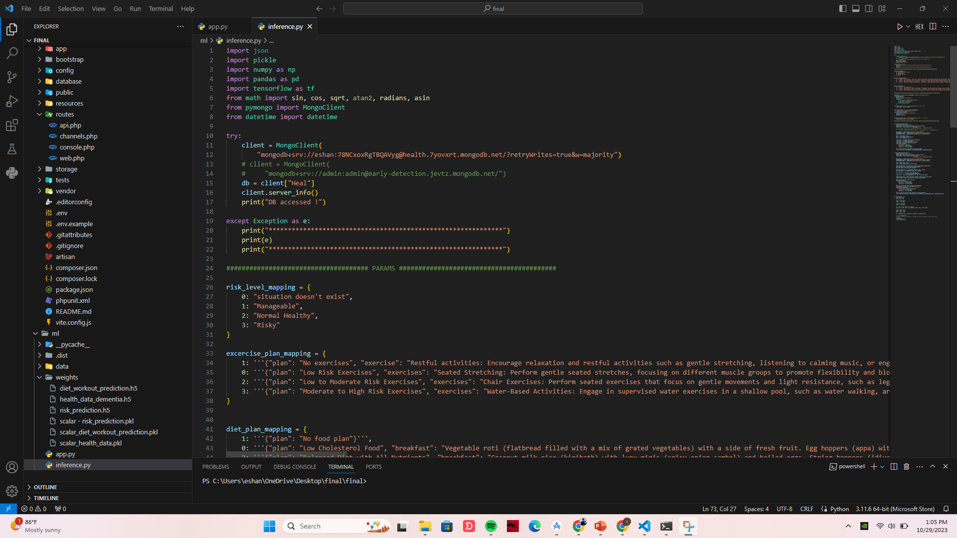

Slide 36
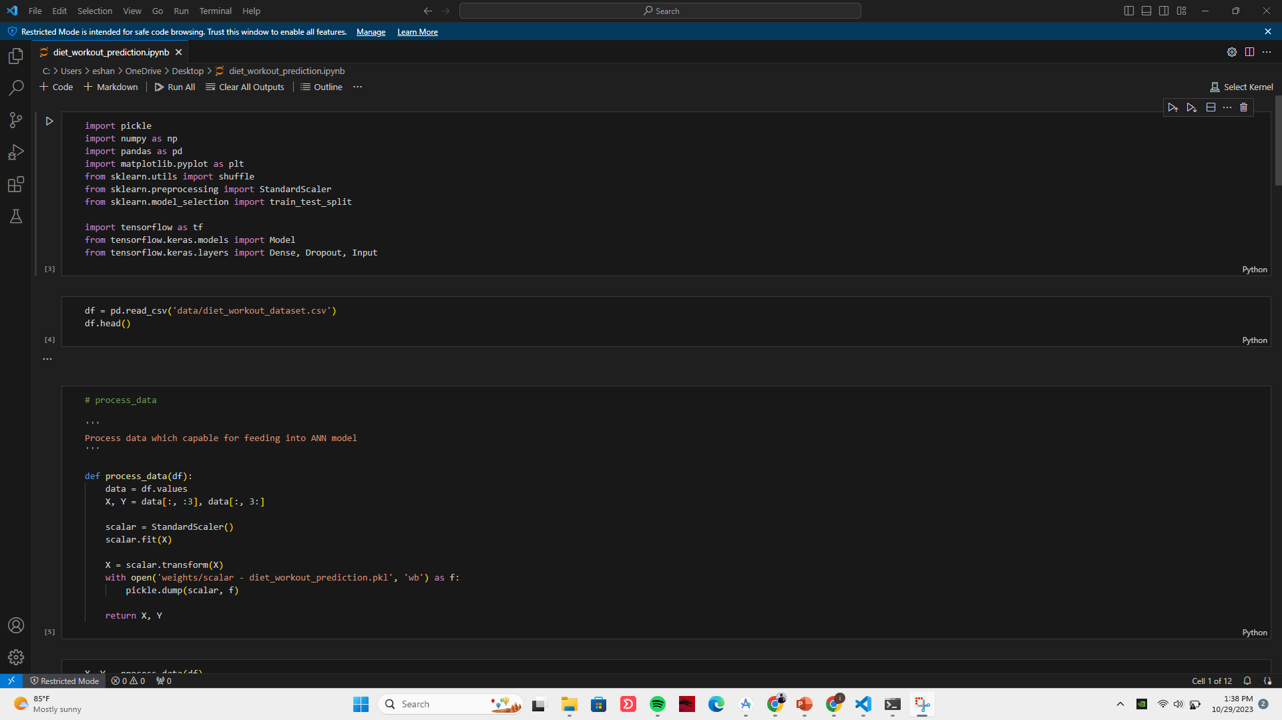
ML Process So Far…
IT20142414 | <<Weerasinghe H.P.E.N>> | <<TMP-23-365>>

Slide 37
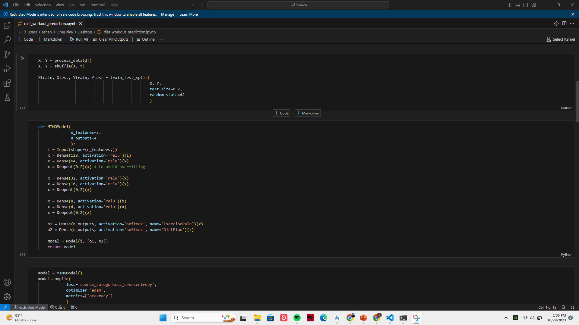

Slide 38
Completion of the Component..
Research Components | Percentage(100%)
Find the Data to train ML algorithm suggest meal and exercise | 100%
Data scaling and Modeling | 100%
Test accuracy of the trained model for prediction with measured data | 100%
Trained ML models connect with the mobile app | 100%
IT20142414 | <<Weerasinghe H.P.E.N>> | <<TMP-23-365>>

Slide 39
RESEARCH GAP
 | Current Health Status | Suggest meal plans specific to each individual. | Provide exercises that are specific to each person | IOT Interaction
HealthifyMe | No | Yes | Yes | Yes
MyFitnessPal | No | Yes | Yes | Yes
A Context-Aware IoT-Based Smart Wearable Health Monitoring System | Yes | No | No | Yes
Personalized Health Monitoring System of Elderly Wellness at the Community Level in Hong Kong | No | Yes | No | Yes
Proposing Application | Yes | Yes | Yes | Yes
IT20142414 | << Weerasinghe H.P.E.N.>> >> | <<TPM-23-365>>

Slide 40
Requirements
System
- Minimum Required RAM: 8 GB
Personal
-Nutritionists & Healthcare professionals
- Python Skills, Machine Learning
Software specification
-VS Code
-GIT Lab
-Python Frameworks
-Testing Tools
IT20142414 | << Weerasinghe H.P.E.N.>> >> | <<TPM-23-365>>

Slide 41
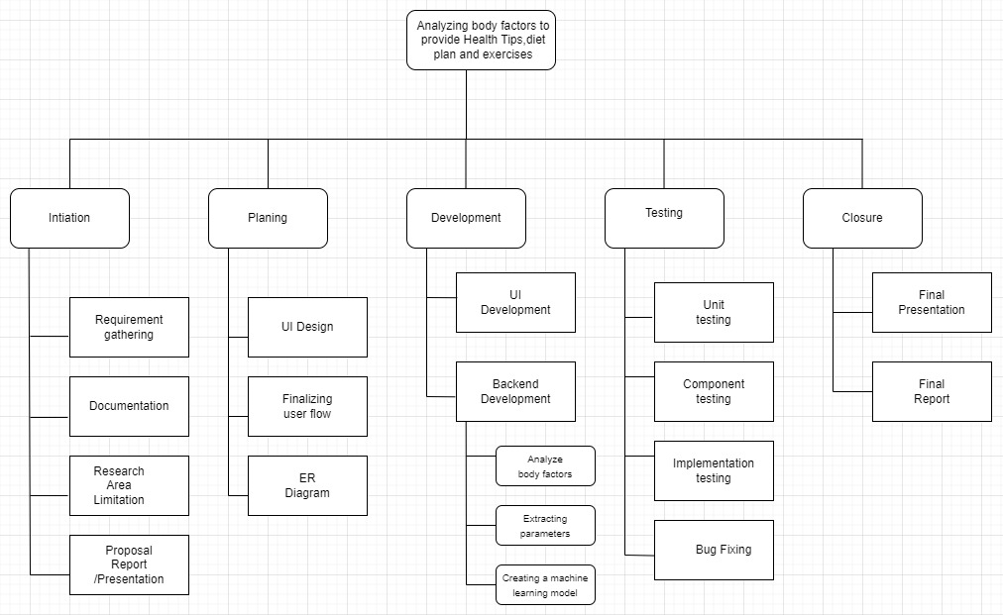
WBS Diagram
IT20142414 | << Weerasinghe H.P.E.N.>> >> | <<TPM-23-365>>

Slide 42
Gantt Chart
IT20142414 | << Weerasinghe H.P.E.N.>> >> | <<TPM-23-365>>

Slide 43
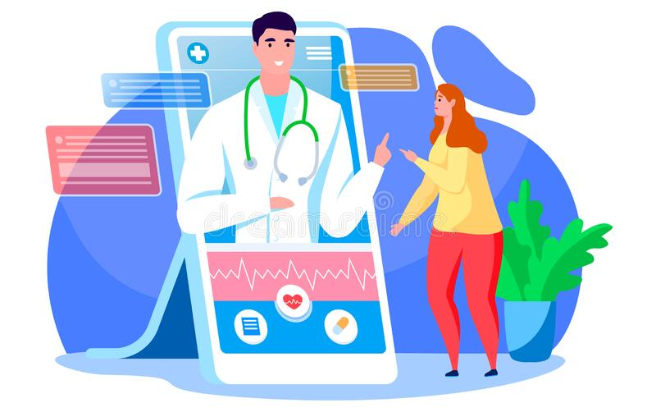
IT20151492 | Warnakulasuriyage K.H.A
Information Technology
IT20151492 | <<Warnakulasuriyage K.H.A>> | <<TMP-23-365>>

Slide 44
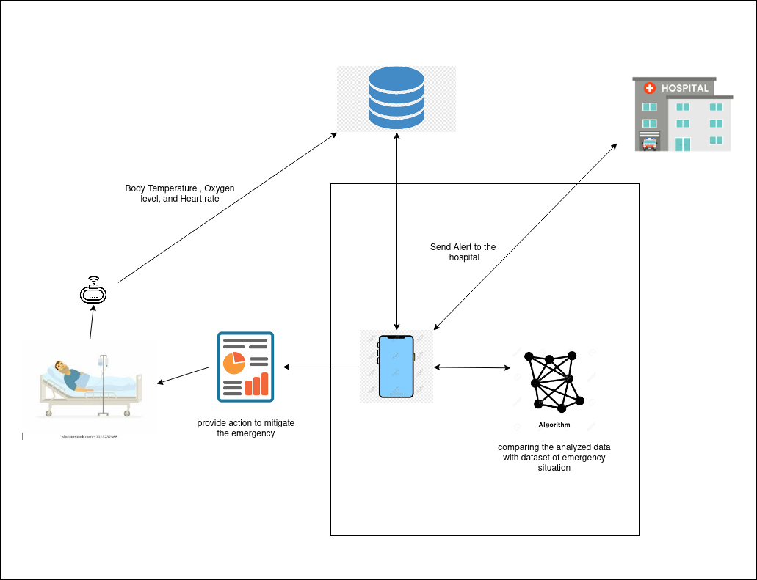
System Diagram
IT20151492 | <<Warnakulasuriyage K.H.A>> | <<TPM-23-365>>

Slide 45
Background
More than 50 million older people worldwide are suffering from dementia, and this number is estimated to increase to 150 million by 2050
Being unable to recall what to do in an emergency is a significant difficulty for someone with dementia. However, it might be fatal because the steps that need to be followed to get rid of it are not instantly recalled.
Researchers are constantly exploring new therapies and screening approaches for the early detection of dementia. Artificial intelligence (AI) is widely applied in dementia research, including machine learning and deep learning methods for dementia diagnosis and progression detection
IT20151492 | <<Warnakulasuriyage K.H.A>> | <<TPM-23-365>>

Slide 46
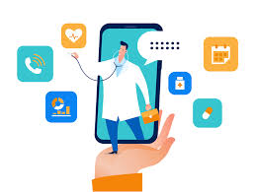
RESEARCH PROBLEM
One potential research problem for this project could be the lack of reliable and accurate data on emergency situations in dementia patients. And they need to know thay have dementia or theya haven’t dementia.
Due to the nature of the condition, dementia patients may not always be able to accurately communicate their symptoms or medical history, which can make it difficult to develop effective algorithms for detecting and responding to emergencies.
Additionally, there may be variations in the way emergency situations present in different individuals, which can make it challenging to develop a one-size-fits-all approach
IT20151492 | <<Warnakulasuriyage K.H.A >> | <<TPM-23-365>>

Slide 47
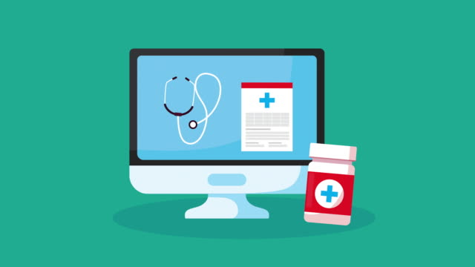
OBJECTIVES
Main Objectives
Using Diabetics , Alcohol ,Weight , MRI delay , Body Temperature , Oxygen level, and Heart rate To develop ML model and check patient have dementia or not and give answer and develop an ML-based system for Emergency situation in dementia patient based on their Body Temperature , Oxygen level, and Heart rate.
Sub Objectives
Analyze the data and identify health conditions through recognition
Comparing the analyzed data with dataset of dementia have situation and
emergency situation
Develop an algorithm to provide action to mitigate the emergency.
In case of emergency, a notification to nearest Hospital or after treatment to the hospital and if the condition does not improve, the notification system to come to visit the patient.
IT20151942 | << Warnakulasuriyage K.H.A >> | <<TPM-23-365>>

Slide 48
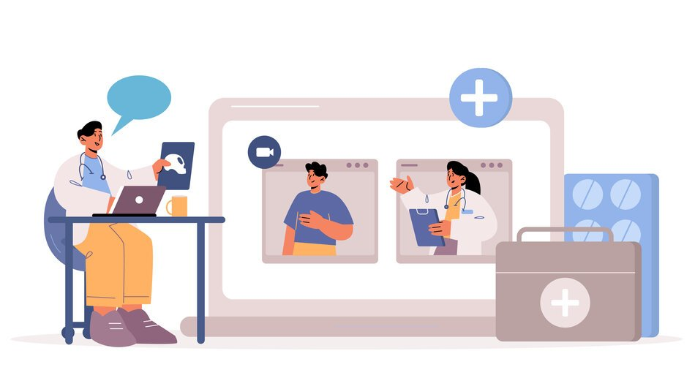
Methodology
Describe the research design and data collection method.
Explain the selection criteria for participants.
Detail the process of data pre-processing, feature selection, and analysis.
Explain the ML algorithms used for the classification of health conditions and the development of the emergency action algorithm.
Describe the criteria used for evaluating the performance of the ML models
IT20151942 | <<Warnakulasuriyage K.H.A>> | <<TPM-23-365>>

Slide 49
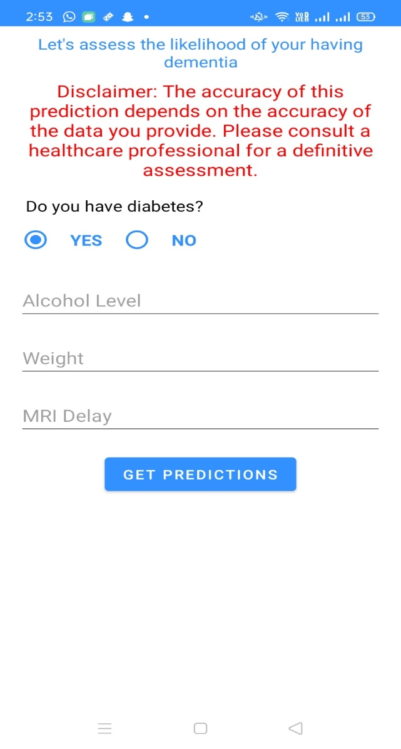
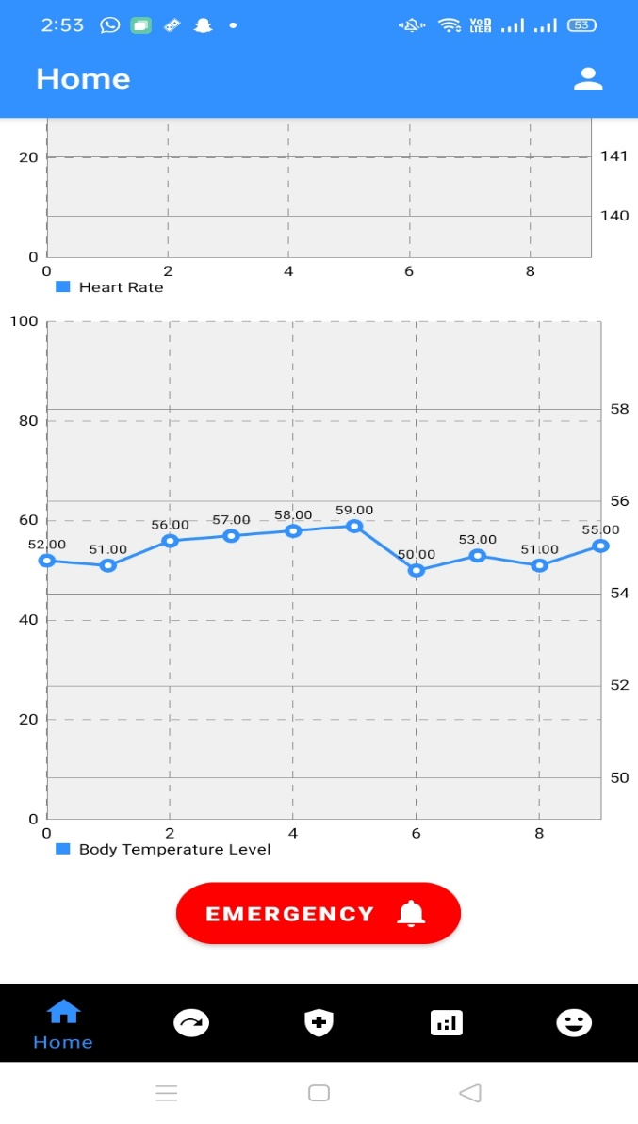
Interfaces
IT20151492 | <<Warnakulasuriyage K.H.A>> | <<TMP-23-365>>

Slide 50
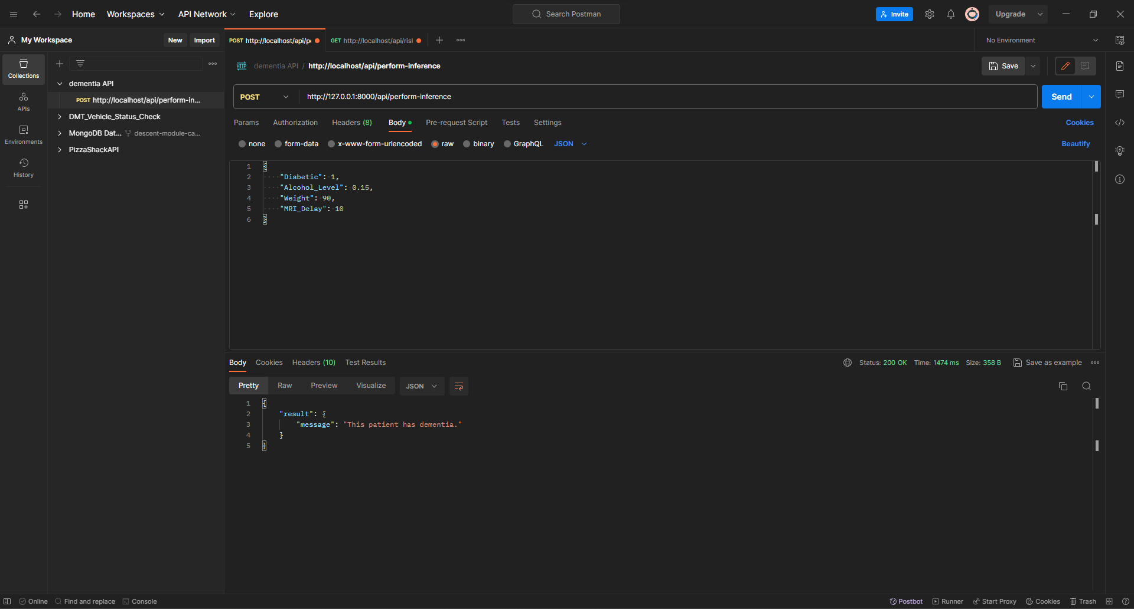
Backend Process..
IT20151492 | << Warnakulasuriyage K.H.A >> | <<TMP-23-365>>

Slide 51
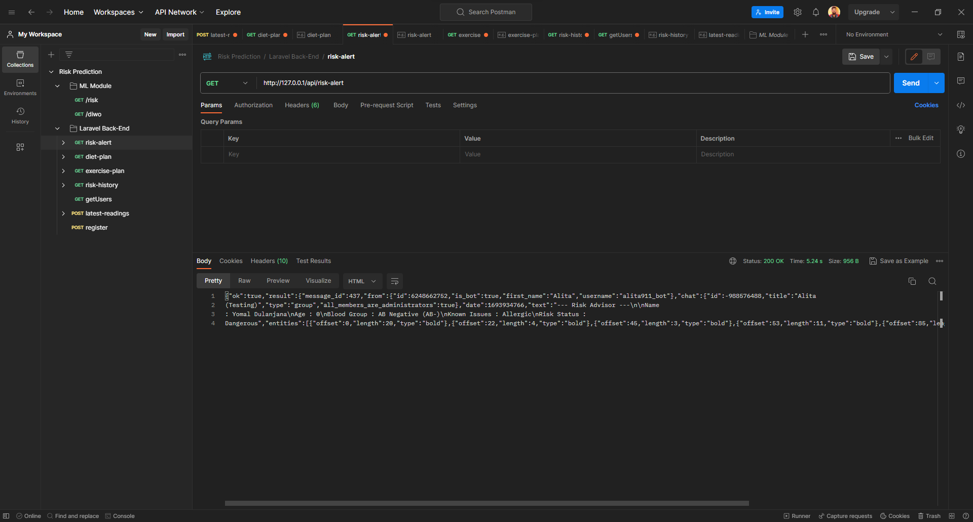
Backend Process..
IT20151492 | << Warnakulasuriyage K.H.A >> | <<TMP-23-365>>

Slide 52
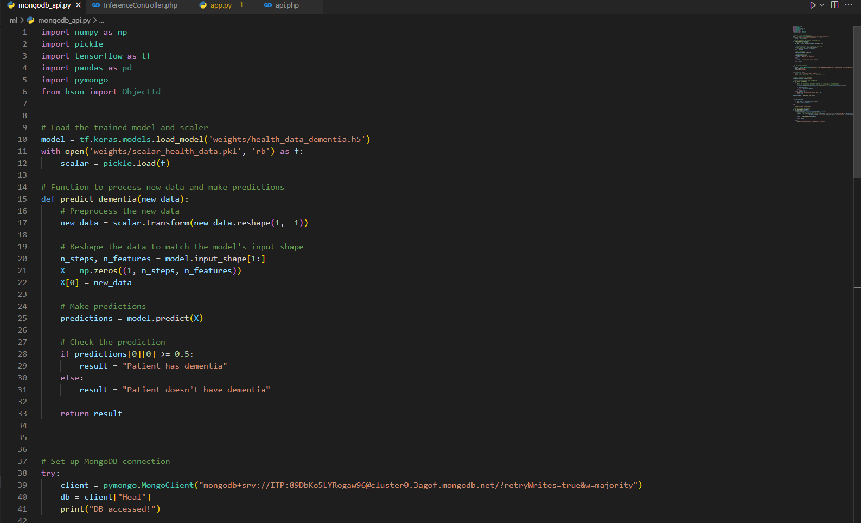
ML Process So Far…
IT20151492 | <<Warnakulasuriyage K.H.A>> | <<TMP-23-365>>

Slide 53

ML Process So Far…
IT20151492 | <<Warnakulasuriyage K.H.A>> | <<TMP-23-365>>

Slide 54
Completion of the Component..
Research Components | Percentage(100%)
Find the Data to train ML algorithm to check Demantia have or not and Emergency Situation and sent alert to caregivers | 100%
Data Preprocessing | 100%
Data scaling and Modeling | 100%
Test accuracy of the trained model for prediction with measured data | 100%
Trained ML models connect with the mobile app | 100%
IT20151492 | <<Warnakulasuriyage K.H.A>> | <<TMP-23-365>>

Slide 55

TECHNOLOGIES TO BE USED
Machine Learning
Deep Learning
Azure Machine Learning Studio
Java
Android studio
Python
Laravel
IT20151492 | << Warnakulasuriyage K.H.A >> | <<TPM-23-365>>

Slide 56
RESEARCH GAP
Mobile App | Related to Identifying Current Health Siatuation | Related to Suggesting Thing what to Do for critical situation | Related to Send alert for nearest hospital
Proposal App | YES | YES | YES
EmoReact | YES | NO | NO
EmoVu | YES | NO | NO
HealthifyMe | NO | YES | NO
A Context-Aware IoT-Based Smart Wearable Health Monitoring System | Yes | NO | NO
Affectiva | YES | NO | NO
IT20151492 | << Warnakulasuriyage K.H.A >> | <<TPM-23-365>>

Slide 57
Requirements
System
- Minimum Required RAM: 8 GB
Personal
-Nutritionists & Healthcare professionals
- Python Skills, Machine Learning
Software specification
-VS Code
-GIT Lab
-Python Frameworks
-Testing Tools
IT20151492 | << Warnakulasuriyage K.H.A >> | <<TPM-23-365>>

Slide 58

WBS Diagram
IT20151492 | << Warnakulasuriyage K.H.A >> | <<TPM-23-365>>

Slide 59
Gantt Chart
IT20151492 | << Warnakulasuriyage K.H.A >> | <<TPM-23-365>>

Slide 60
Reference
Zhang, Y. W.; et al. (2011). APP processing in Alzheimer's disease. Molecular brain. 2011, 4(1): 1-13
https://doi.org/10.1111/j.1748-3743.2006.00016.x
https://www.cambridge.org/core/journals/cambridge-prisms-precision-medicine/article/applications-of-artificial-intelligence-in-dementia-research/A62C6F50BFD1E3158578B0D7580E403A
Age Concern England. (2007). Improving services and support for older people with mental health problems. London, UK: Age Concern England. Retrieved from http://www.ageconcern.org.uk/AgeConcern/Documents/full_report.pdf.

Slide 61
IT20121242 | SerasinghA K.A.E.Y.D.
Information Technology
IT20121242 | <<SERASINGHA K.A.E.Y.D.>> | <<TMP-23-365>>

Slide 62

System Diagram
IT20121242 | <<SERASINGHA K.A.E.Y.D.>> | <<TMP-23-365>>

Slide 63
Background
The use of IoT devices in healthcare has grown significantly, providing real-time health data for patients. However, the data can be overwhelming, and machine learning techniques are being explored to analyse it. Monthly health reports can be generated for patients based on IoT data, providing valuable insights. Machine learning enables healthcare professionals to make informed decisions, leading to a more efficient and effective healthcare system.
IT20121242 | <<SERASINGHA K.A.E.Y.D.>> | <<TMP-23-365>>

Slide 64
RESEARCH PROBLEM
While the use of machine learning and IoT devices in healthcare has the potential to improve patient outcomes, there are several challenges that need to be addressed.
One critical challenge is ensuring the security and privacy of patient data collected by IoT devices.
The collection and storage of this data can be vulnerable to cyberattacks, putting patients' sensitive health information at risk.
Therefore, research is needed to identify and develop secure and reliable data storage and transmission systems that protect patient data while also enabling efficient and effective healthcare management.
IT20121242 | <<SERASINGHA K.A.E.Y.D.>> | <<TMP-23-365>>

Slide 65
OBJECTIVES
Main Objectives
Using machine learning, we generate monthly health reports for patients by processing data from IoT devices, automatically transmitting the reports to designated doctors, and providing future health predictions based on collected data.
Sub Objectives
Identify and select appropriate IoT devices for data collection such as wearable health trackers, smart scales, blood pressure monitors, etc.
providing future health predictions based on collected data.
Collect and store patient data from IoT devices in a secure database or cloud storage.
Develop a reporting system that generates monthly reports based on the insights extracted from the data.
IT20121242 | <<SERASINGHA K.A.E.Y.D.>> | <<TMP-23-365>>

Slide 66
Methodology
To Implement Physical Device To Measure Human facts with IOT:
Mini LCD Display
Max30102 Heart Rate and Pulse Oximeter Sensor
GY-906-BCC Non-Contact Infrared Temperature Sensor Module
ESP8266 Module
To Implement Functionality to Report and Future Predictions :
Machine Learning Algorithm (GRU)
Python
Tools and Technologies:
Arduino IDE, Google Collab, JAVA, Azure and Visual Studio
IT20121242 | <<SERASINGHA K.A.E.Y.D.>> | <<TMP-23-365>>

Slide 67

A multi-functional device to give accurate data for Blood Oxygen, Heart Rate, & Body Temperature Measurement.
ESP8266 Node MCU Module
Max30102
IR Sensor
Mini LCD Display
IT20121242 | <<SERASINGHA K.A.E.Y.D.>> | <<TMP-23-365>>

Slide 68



Contd.
IT20121242 | <<SERASINGHA K.A.E.Y.D.>> | <<TMP-23-365>>

Slide 69
Completion of the Component..
Research Components | Percentage
Do research about to gather details to sketch the basic structure of the device and design circuit diagram. | 100%
List out and find items need to build the device according to circuit diagram. | 100%
Soldering and coding Hardware components. | 100%
Set Wi-fi connectivity with physical device. | 100%
Set Realtime database to store measured data by device. | ongoing
Implement system backend system to pass measured data from device. | Ongoing
IT20121242 | <<SERASINGHA K.A.E.Y.D.>> | <<TMP-23-365>>

Slide 70



Interfaces
IT20121242 | <<SERASINGHA K.A.E.Y.D.>> | <<TMP-23-365>>

Slide 71

Backend Process..
IT20121242 | <<SERASINGHA K.A.E.Y.D.>> | <<TMP-23-365>>

Slide 72


Slide 73


Slide 74
ML Process So Far…
IT20121242 | <<SERASINGHA K.A.E.Y.D.>> | <<TMP-23-365>>

Slide 75
Completion of the Component..
Research Components | Percentage(100%)
Find the Data to train ML algorithm to Report and Future Predictions for patients | 90%
Data Preprocessing | 90%
Data scaling and Modeling | ongoing
Test accuracy of the trained model for prediction with measured data | ongoing
Trained ML models connect with the mobile app | ongoing
IT20121242 | <<SERASINGHA K.A.E.Y.D.>> | <<TMP-23-365>>

Slide 76


